Slide 1

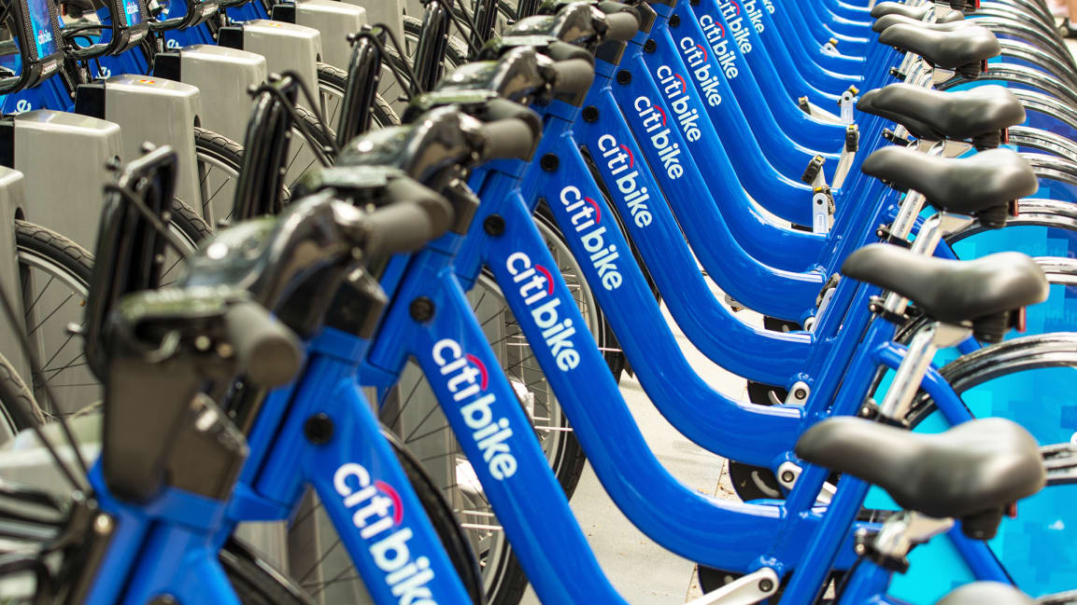
Bike Station Clustering Analysis September 26, 2019

Slide 2
APPENDIX
3 | INTRODUCTION
4 | DATA
5 | ANALYTIC APPROACH
6 | UNSUPERVISED LEARNING RESULTS Pt1
7 | UNSUPERVISED LEARNING RESULTS Pt2
8 | CONCLUSION

Slide 3
INTRODUCTION
Objective: Explore Citi Bike rider dataset through clustering techniques to uncover any potential commonality, trends, and behaviors that can help improve the program’s operation.

Slide 4
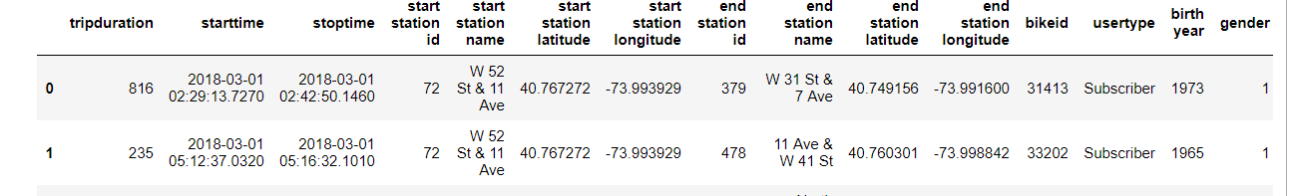
DATA
March 2018 Data
Greater NYC geographic area
Weather data is acquired from Weather.gov based on the Central Park station.
All Citi Bike Program data is acquired from Citibikenyc.com.
Notes:
For the purpose of the exercise, single month of data from March 2018 is used and we are assuming that observations made are applicable to other months of the year. Single month used is due to limitation in computing capacity.
Data includes all geographic areas of the Citi Bike program. Areas include Manhattan, Queens, Brooklyn, and Jersey City. Bronx and Staten Island are not covered by the Citi Bike Program.
Weather data is acquired from Weather.gov based on the Central Park station.
All Citi Bike Program data is acquired from Citibikenyc.com.

Slide 5
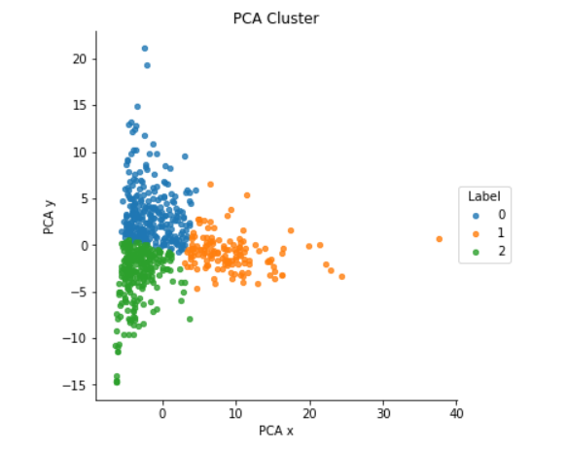
ANALYTIC APPROACH
Initial exploratory data analysis is done to note of any easy to observe patterns in the overall data.
Second part is to apply Unsupervised Learning to the data as they are not labeled.
K-Means is chosen for this exercise.
Component reduction has been used
Utilized 3 clusters
Primary unit data is distance
Notes:
K-Means is chosen for this exercise.
PCA with K=2 based on Elbow method.
Cluster of 3 is chosen as it splits the data most cleanly and the clusters do not overlap much. Cluster of 2, 4, and 5 have been tested as well.
Ran on distance of rides for starting station. Also ran on ending station and the results are very similar.

Slide 6
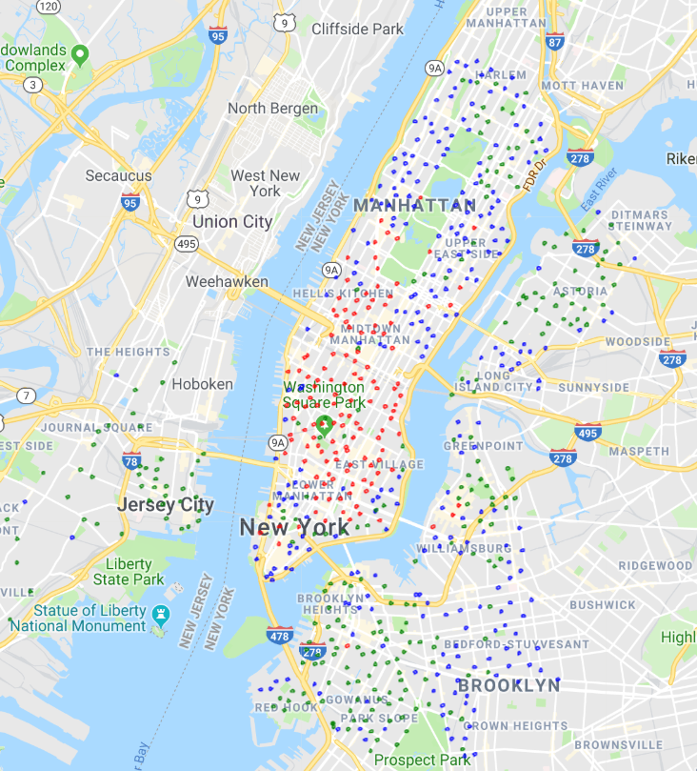
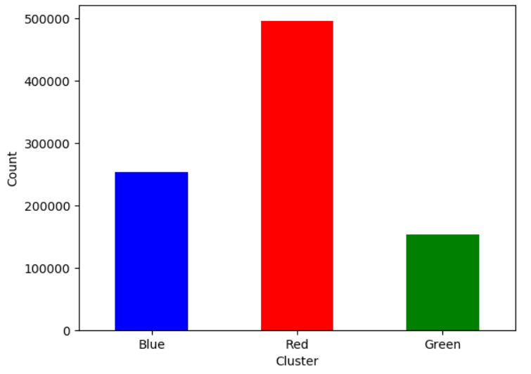
UNSUPERVISED LEARNING RESULTS
Clusters are split into Red, Green, and Blue points.
Each cluster has distinct geographic locations
Notes:
Red Cluster –
This is largest cluster accounting for 55% of all rides within the system. Geographically it is located south of Central Park and north of Financial District.
Blue Cluster –
This cluster accounts for 28% of all rides. Geographically it is spread out in the outer part of Brooklyn, Long Island City, Upper West Side, Upper East Side, and South of Houston Street.
Green Cluster –
This cluster accounts for the remaining 17% riders. Geographically it is spread in central Brooklyn, Jersey City, Astoria, and East Harlem.

Slide 7
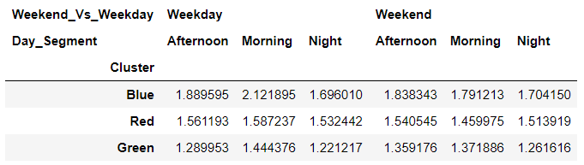
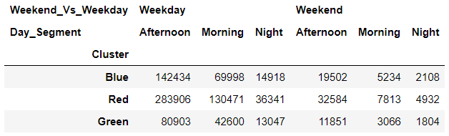
UNSUPERVISED LEARNING RESULTS
Blue Cluster and Green Cluster are very different from distance measurements but are geographically intertwined.
Red Cluster is unique compared to the Blue and Green Clusters. It is geographically separate and has very different behaviors.
Distance in KM
Count
Notes:
Blue Cluster has the longest trips whilst Green has the shortest trips across all periods of a week. This significant differential is quite interesting as both clusters overlap quite a bit in Queens and Brooklyn.
A likely reason has to do with the location of work for the residences.
Blue Cluster seems to be a group of people living further away from central business hubs and are thus have longer commuters. This cluster peaked at 2.1KM on Weekday mornings which is significantly higher than all other time periods & clusters. The Upper West, Upper East, and stations near Bridges are most likely used by commuters to Manhattan business districts, and the area on the eastern edge of Brooklyn system is most likely used for people who work in central Brooklyn.
Green Cluster on the other hand seems to be aggregating riders who are commuting in the local areas in the Brooklyn, Astoria, Jersey City, and East Harlem areas. It also has a peak on Weekday mornings.
It interesting to note that areas that are similar to each other in terms of demographics and are geographically close by such as Astoria & Long Island City, and Greenpoint & Williamsburg, are clearly split into separate clusters. The primary difference between them is that one is right next to a bridge to Manhattan and the other is not.
There seems to be a threshold for commuting distance where people switch from taking the train to riding bikes instead.
Red Cluster is unique compared to the Blue and Green Cluster. It does not overlap as much with the other two clusters as it sits almost exclusively in central Manhattan.
The distance traveled in all periods of the week are relatively consistent. There is no significant increase in distance during Weekday mornings like the other two clusters.
This illustrates a point the Manhattan riders most likely only commute within Manhattan itself and do not go to other boroughs. The exception to this once again lies near areas close by to bridges.
The additional population density and cost of owning vehicles in Manhattan adds to the incentive for people to choose bike as a primary source of transportation for a broader range of purpose besides commuting to work.

Slide 8
CONCLUSION
Rider behaviors are heavily dependent on the location of the starting station.
Can be applied to help determine placement of future docking stations.
This analysis can help forecast the rate of bike replacement, utilization rate, loss rate, etc.
Additional areas of expansion
Notes:
Based on the observations, we can conclude that rider behaviors is heavily dependent on the location of the starting station.
The information can be applied to help determine placement of future docking stations as it provides insight into how the station will be utilized depending on geographic location.
For these new stations, this analysis can help forecast the rate of bike replacement, utilization rate, loss rate, etc. To get the full forecast, additional data will be needed such as loss data and dock idle data, but that is beyond the scope of this exercise.
Another area to expand on for this analysis is to include all 12 months of the year into the data set rather than one month. This will require additional computing power.

